Slide 1

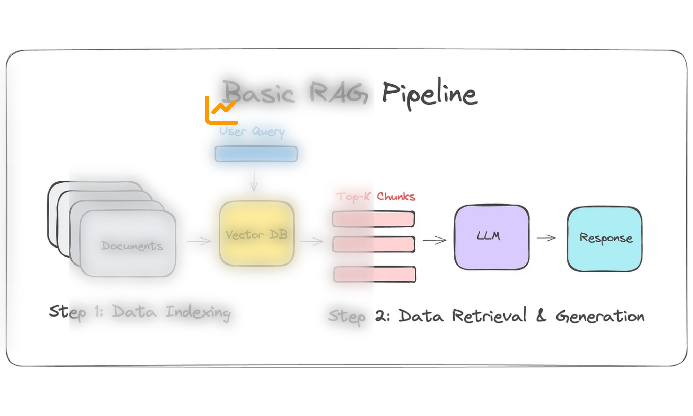



Engine-Agnostic ML Pipeline with RAG Support
A comprehensive framework for training, evaluating, and deploying both traditional ML and Retrieval-Augmented Generation models using multiple distributed computing engines
Multi-Engine Support
Advanced RAG Types
Comprehensive Evaluation
Dask, Spark, Ray integration for distributed computing
Adaptive, Corrective, and Self-RAG implementations
Robust metrics for RAG and code generation assessment

Slide 2

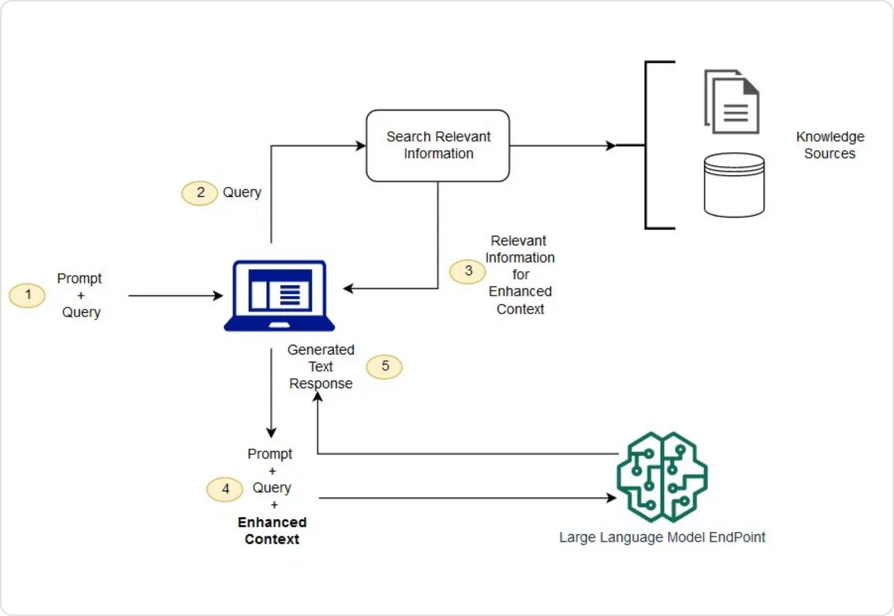



Architecture Overview
Layered Architecture
Engine-Agnostic Design
Application Layer:
Command-line interface and Airflow DAGs
Trainer Layer:
Abstract base classes and factory methods
Engine Layer:
Dask, Spark, and Ray implementations
Evaluation Layer:
Comprehensive metrics framework
Infrastructure Layer:
Docker containers and security
RAG Integration
Extended trainer interface with RAG-specific methods
Enhanced factory pattern for model type selection
Specialized evaluation metrics for RAG models
Key Design Principles
Backward compatibility with existing pipeline
Consistent interface across engines
Engine-Agnostic ML Pipeline with RAG Support
Architecture Overview

Slide 3

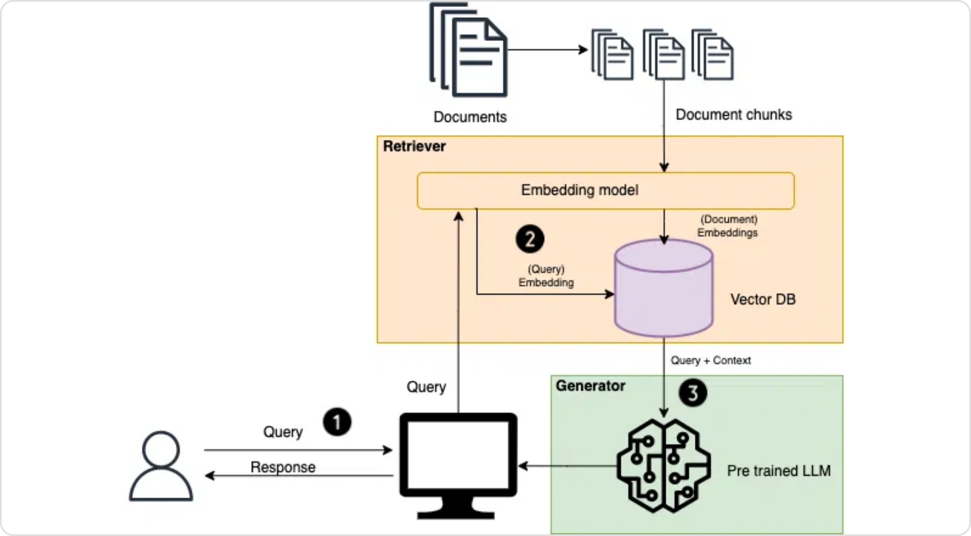





RAG Capabilities
RAG Types
RAG Architecture
Adaptive RAG
Dynamically selects retrieval strategy based on query complexity. Uses a classifier to determine the appropriate approach for each query.
Corrective RAG
Improves retrieval quality by scoring and filtering documents based on relevance. Reduces hallucinations and improves answer accuracy.
Self-RAG
Enables self-reflection on retrieval decisions and generation quality. The model can critique its own outputs and refine responses.
Implementation Approaches
Lightweight Approach
CPU-friendly implementation using scikit-learn and TF-IDF for efficient retrieval. Ideal for environments without GPU access.
Transformer Approach
More accurate implementation using Hugging Face transformers. Requires more computational resources but delivers higher quality results.
Engine-Agnostic ML Pipeline with RAG Support
RAG Capabilities

Slide 4

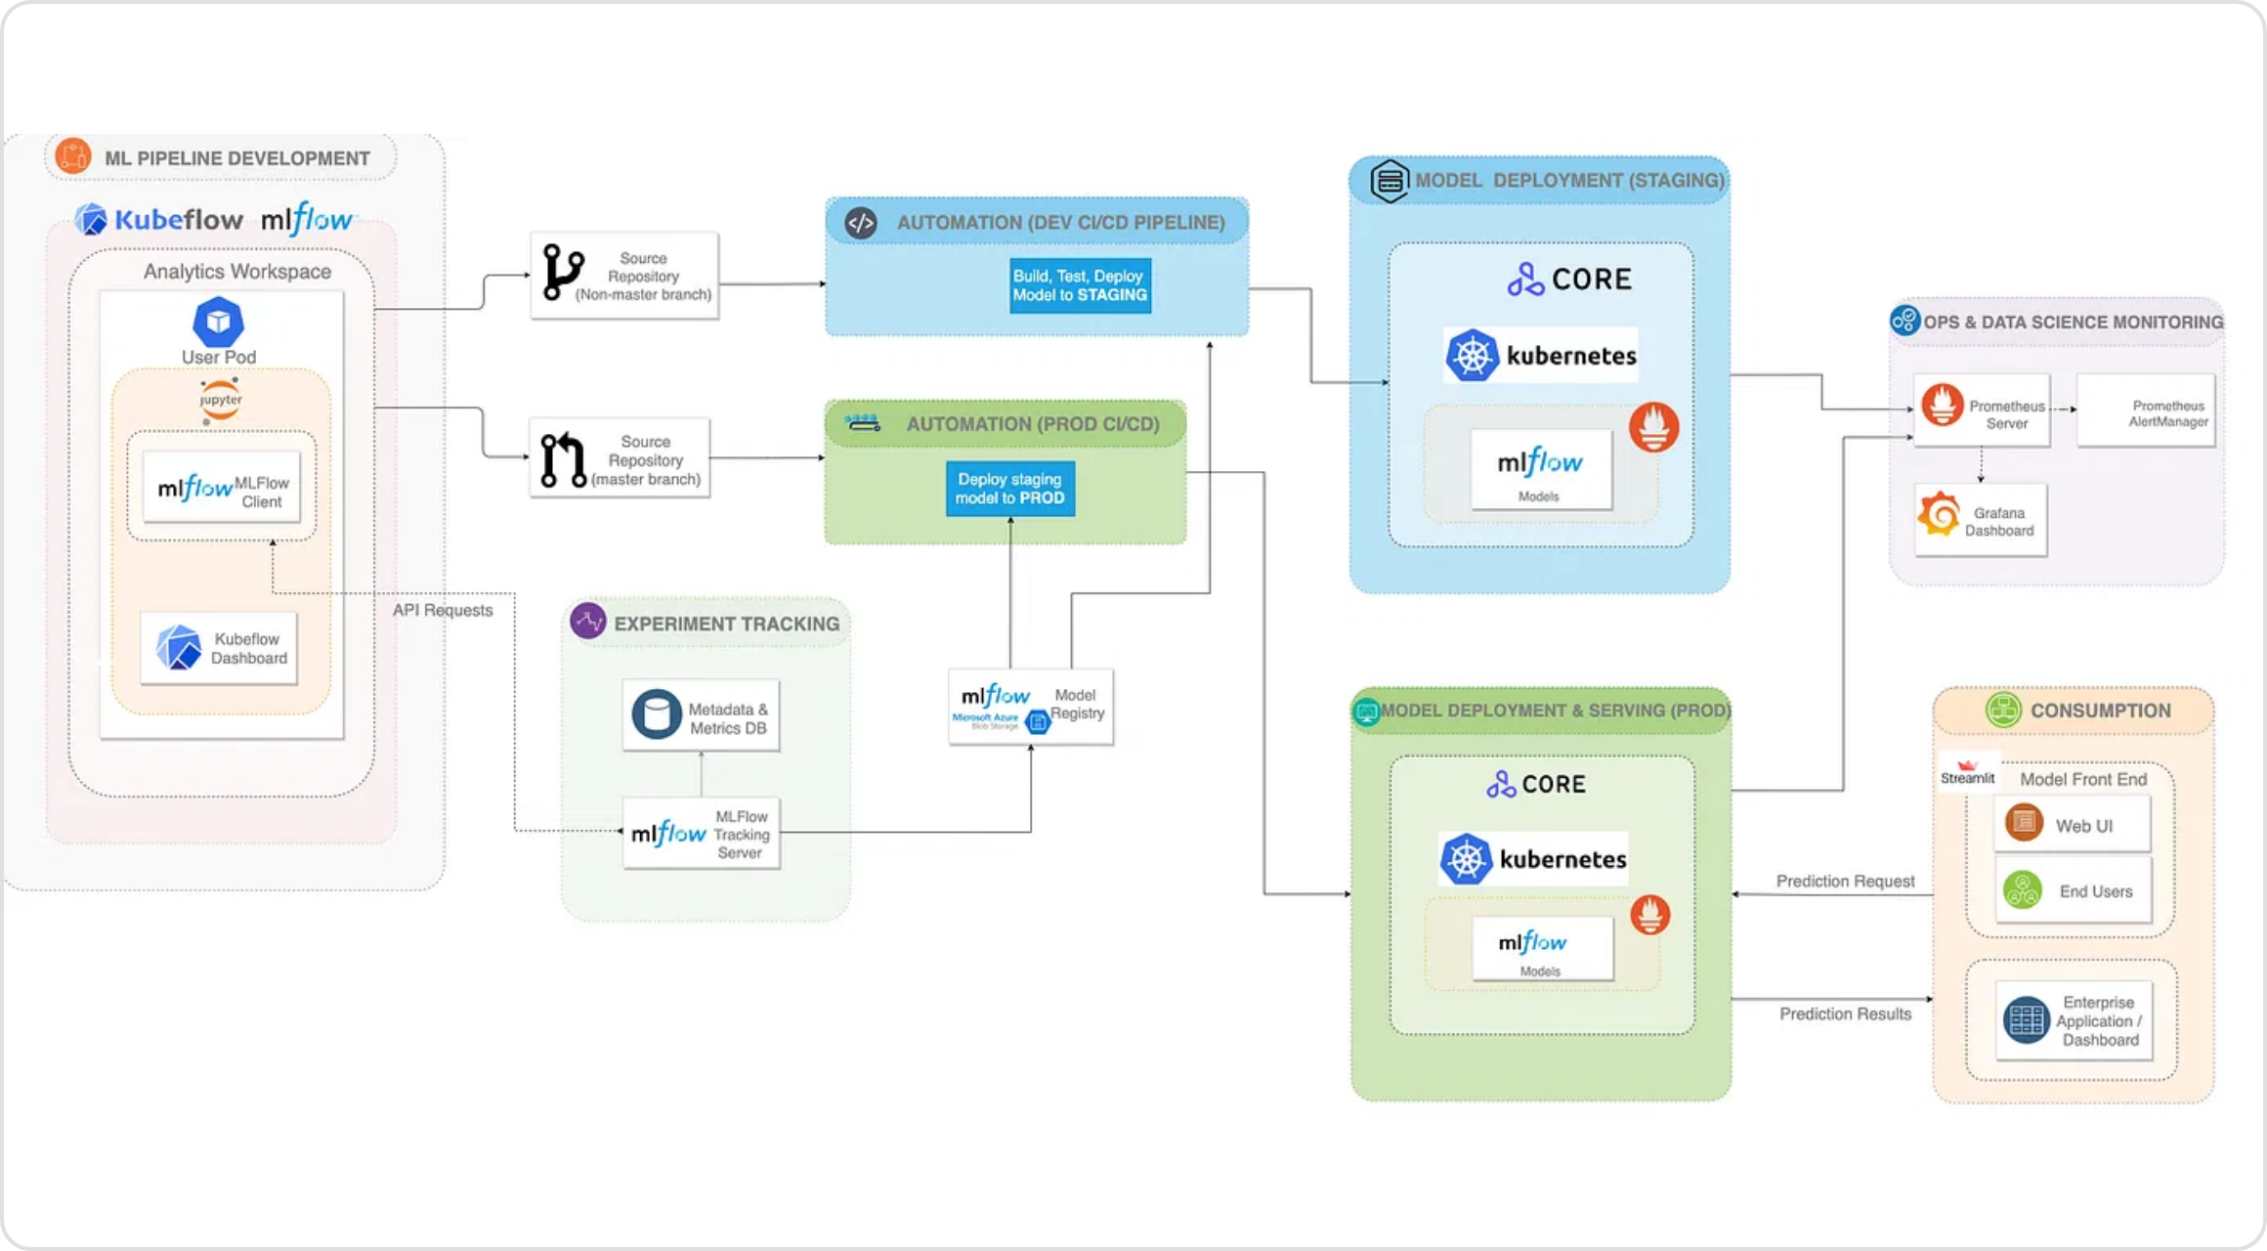



Multi-Engine Support
Engine-Agnostic Architecture
Distributed Computing Engines
Dask
Parallel computing library that scales Python. Excellent for CPU-intensive RAG training with efficient memory management.
Distributed DataFrame
Task Scheduling
Memory Efficiency
Spark
Fast and general-purpose cluster computing system. Great for large datasets with MLlib integration.
RDD Operations
MLlib Integration
SQL Support
Ray
# Factory pattern for engine selection
def get_rag_trainer(engine: str, rag_type: str):
Framework for scaling Python applications. Optimal for parallel processing and hyperparameter tuning.
if engine == "dask":
return DaskRAGTrainer(rag_type)
elif engine == "spark":
Actor Model
Ray Tune
Distributed Training
return SparkRAGTrainer(rag_type)
elif engine == "ray":
return RayRAGTrainer(rag_type)
Engine-Agnostic ML Pipeline with RAG Support
Multi-Engine Support

Slide 5

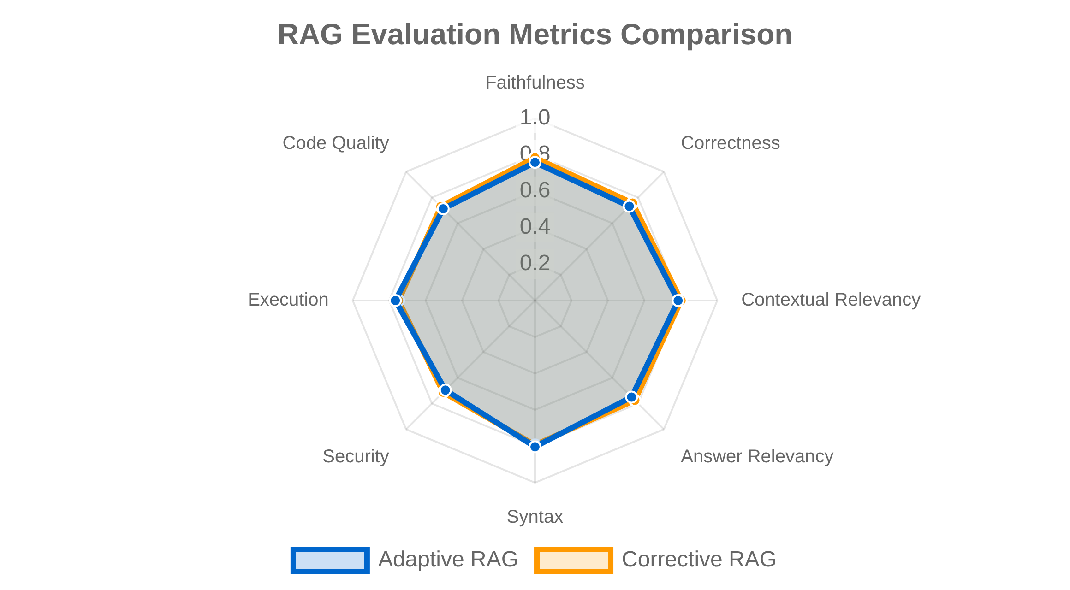










Comprehensive Evaluation
Evaluation Framework
Evaluation Pipeline
# Comprehensive evaluation pipeline
class EvaluationPipeline:
def __init__(self):
self.rag_evaluator = RAGEvaluator()
self.code_evaluator = CodeEvaluator()
def evaluate_single_sample(self, question,
context, generated_answer, ground_truth=None,
test_cases=None):
# RAG evaluation
faithfulness = self.rag_evaluator.evaluate_faithfulness(
question, context, generated_answer)
# Code evaluation if applicable
if self._contains_code(generated_answer):
code = self._extract_code(generated_answer)
syntax = self.code_evaluator.evaluate_syntax(code)
RAG-Specific Metrics
Key Benefits
Faithfulness
Correctness
Contextual Relevancy
Comprehensive assessment of RAG quality
Answer Relevancy
Specialized code generation metrics
CPU-friendly implementation
Code-Specific Metrics
Detailed reasoning for each score
Syntax Validation
Security Assessment
Execution Testing
Batch processing for efficient evaluation
Code Quality
Engine-Agnostic ML Pipeline with RAG Support
Comprehensive Evaluation

Slide 6

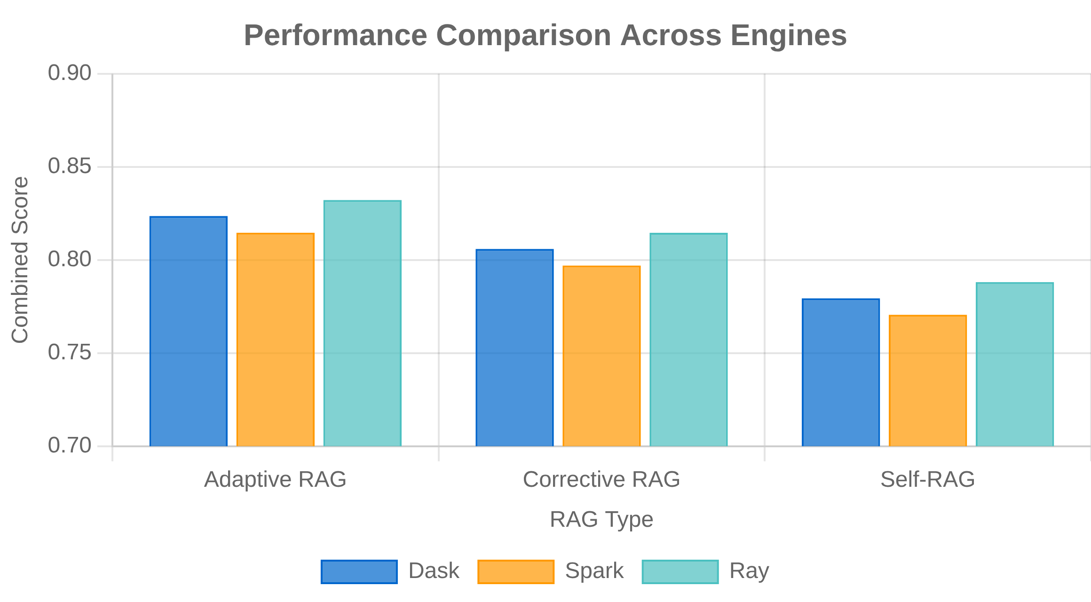


Demonstration Results
Performance Metrics
Sample Demonstration
Query:
How do I create a function to multiply two numbers?
def multiply(a, b): """ Multiply two numbers and return the result. Args: a: First number b: Second number Returns: The product of a and b """ return a * b
Key Achievements
Backward Compatibility:
Maintained all existing functionality while
adding RAG capabilities
CPU-Optimized Design:
Efficient implementation for environments
without GPU access
Comprehensive Evaluation:
Robust metrics for both RAG and code
Test Results Summary
generation quality
Production-Ready Architecture:
Security scanning, SBOM generation,
Combined Score
0.840
RAG Score
0.800
Code Score
0.875
and Hugging Face integration
Training Time
2.00s
Multi-Engine Support:
Consistent interface across Dask, Spark, and Ray
engines
Engine-Agnostic ML Pipeline with RAG Support
Demonstration Results

